Slide 1
US Prevailing Wage Program

Slide 2
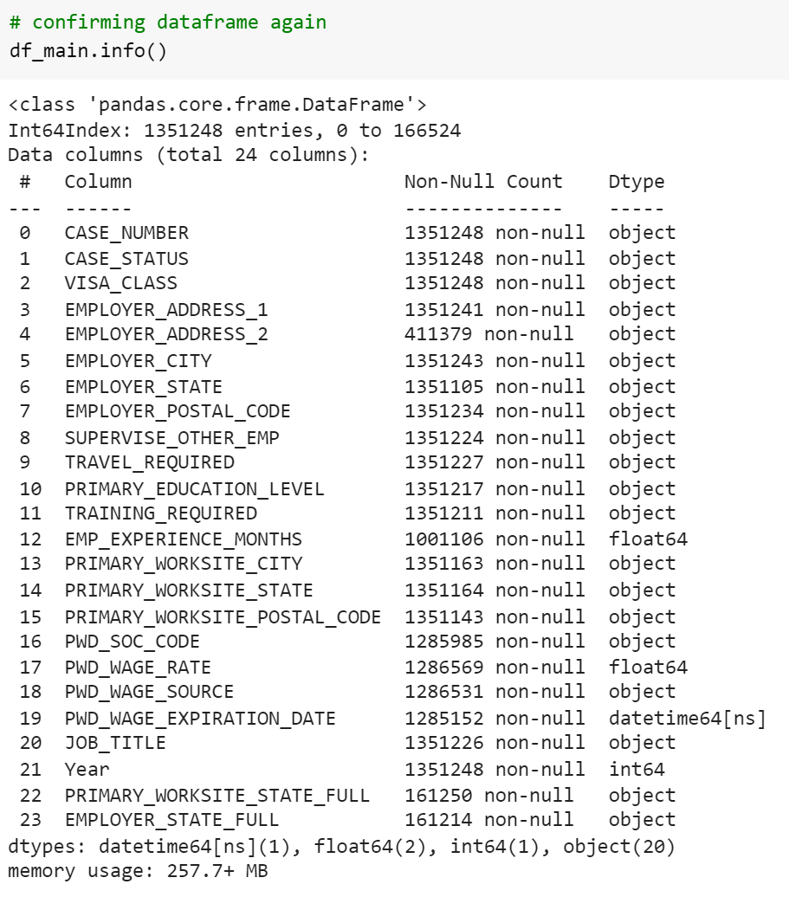
Main Dataframe
US Prevailing Wage Program
Spanning from 2012 to 2020
Data Preprocessing steps include:
dropping misaligned columns
identifying and replacing repetitive data
concatenating the data from all the years into the main_df
Notes:
Pranshu:
To give a brief overview of the data -
We have 9 years of data consisting of different case numbers, the wage rate, their visa class etc. from 2012-2020 which gives an overview of the wages earned by people living in different areas within United States
There were certain columns not present in the initial years but were present in the latter ones. Therefore to maintain consistency, we eliminated some of the columns and renamed some which ideally contained the same information.
There were multiple columns where the data had to be replaced so that we can have some consistency within columns. Eg. the state names were GA and Georgia as well, so we renamed to GA
After cleaning the data, we concatenated all the dataframes from different years into one called the main_df

Slide 3
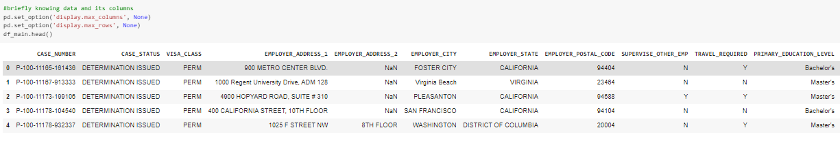
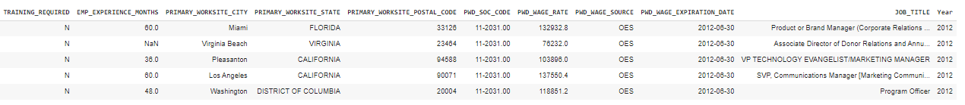
Main Dataframe Output
Notes:
Pranshu:
This is a visual representation of the main dataframe with all the columns that we’re utilising.

Slide 4
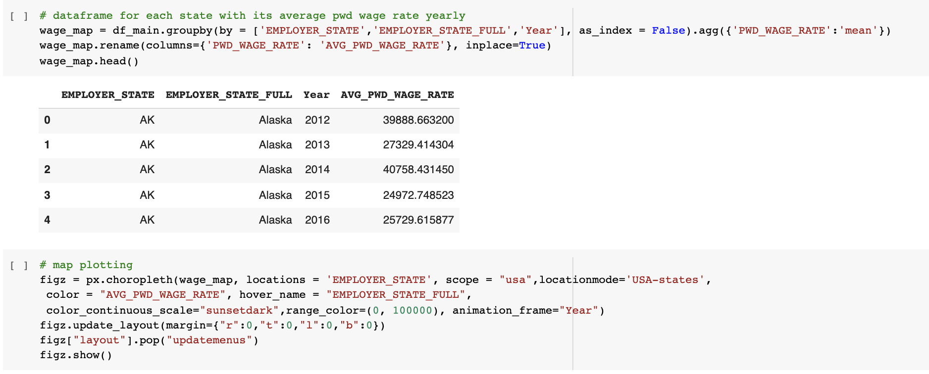
Plotting PWD Wage on US Map Using Plotly
Notes:
Pranshu:
The full name of PWD is Prevailing Wages Determined, which means the average wage paid to similarly employed workers in a specific occupation in the area of intended employment.
We can simply understand it as the average salary in the local area.
We recreated a new dataframe about the average salary of each region for each year from the original dataframe

Slide 5
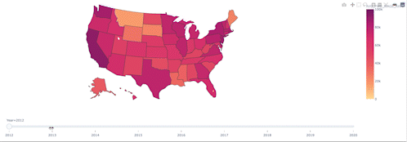
Average PWD Wage by Year and State
The above US map shows the average PW program wage by state and year. Darker colors indicate a higher wage, and hovering over the state shows the average wage for the selected year.
Notes:
Pranshu:
Compare to past, employers in nowadays are willing to pay more wages to foreign talents
California and Washington have remained the top paying states to employees from 2012 - 2020. Pennsylvania, Illinois, New York, Georgia, Virginia and Texas have seen a steady increase over this time period.

Slide 6
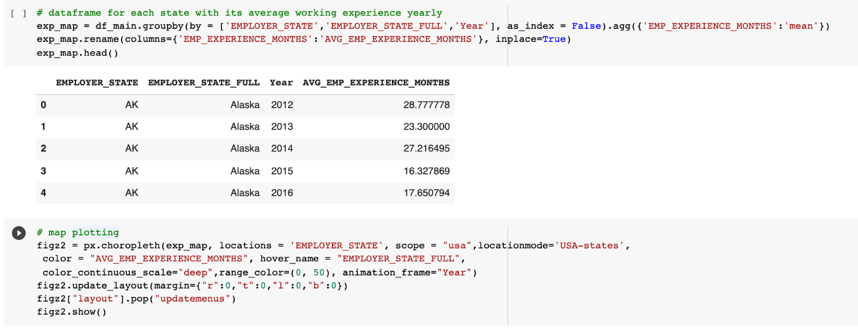
Plotting Working Experience on US Map Using Plotly
Notes:
Lin:
We create a dataframe about the average working experience of each states for each year

Slide 7
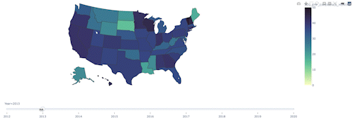
Average Work Experience by Year and State
Average work experience of employees in a state by year from 2012-2020. Darker color indicates that employees in a state have, on average, more years of work experience.
Notes:
LLin:
Lin:
We can see that compared with eight years ago, the requirements for work experience in the United States have decreased. Employers in nowadays are giving more opportunities to fresh graduates.
In California, work experience for employees has decreased significantly since 2014. North of the Rocky Mountain regions have consistently required less work experience. Georgia fluctuate in terms of work experience starting with a decrease but then increasing again in the more recent years.

Slide 8
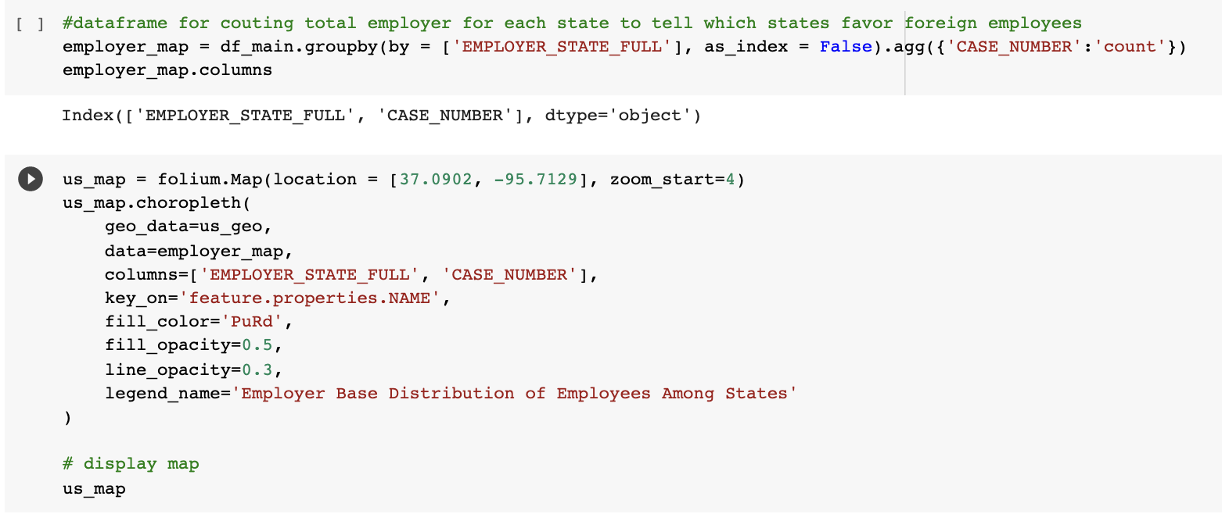
Code for Employer Base Distribution
Notes:
Lin:
We aggregate the number of total employer for each states based on the case_number.
Then, we plotting the maps by using folium package and json file

Slide 9
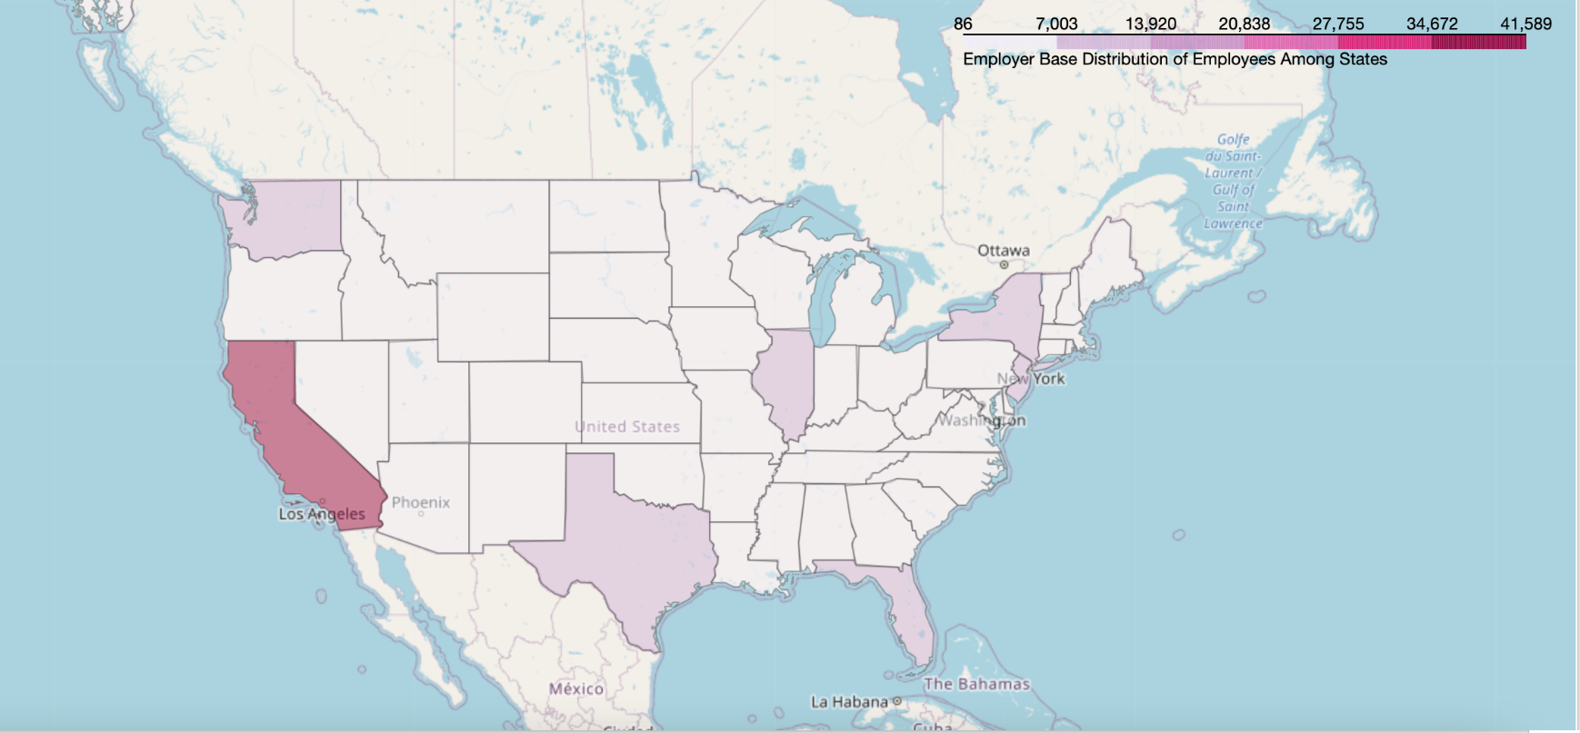
Employer Base Distribution Among States
The above US map shows the concentration of the location of employers that are hiring the greatest number of participants in the PW program by state. States with darker colors are home to companies hiring the most participants.
Notes:
Lin:
California has most companies that employ immigrants the most , followed by Texas, Washington, Florida, Illinois, New York, and New Jersey.
We can tell that the more developed the region, the more inclined to recruit foreign employees.

Slide 10
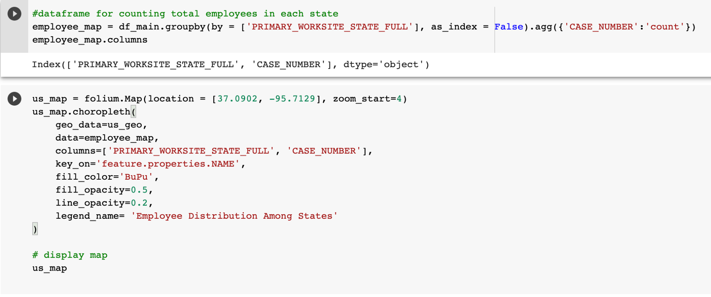
Code for Employee Distribution
Notes:
Lin:
We create a dataframe by aggregating the number of total employee located in each states based on case_number ,
Then, we plotting the maps.

Slide 11
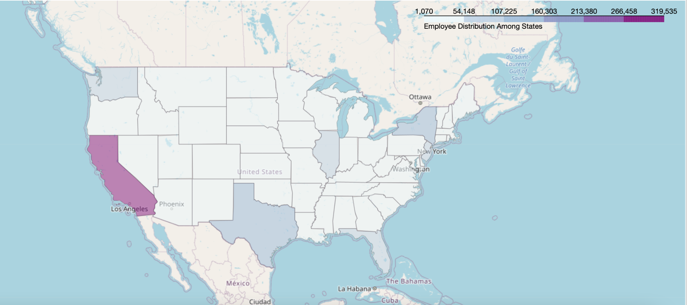
Employee Distribution Among States
The above US map shows the concentration of employees in the PW program by state. More participants work in the darker colored states.
Notes:
Lin:
California has the highest distribution of employees, followed by Texas, Washington, Florida, New York, Illinois, and New Jersey.
This matches up with the data from the previous plot which showed employer distribution.
These regions are willing to pay more salaries to foreign employees than in other regions, which may be the reason why foreign employees are prefer to locate.

Slide 12
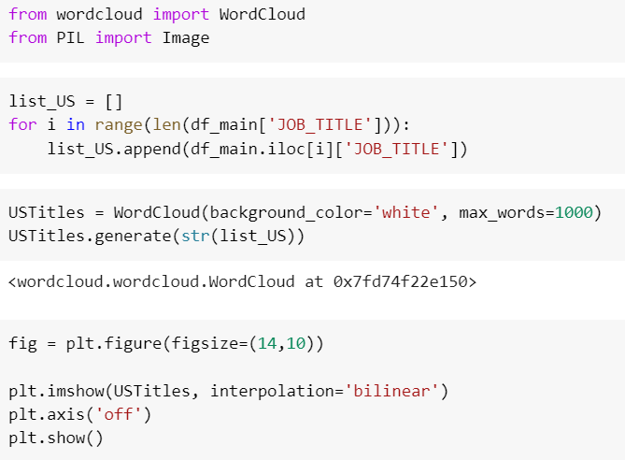
Code for Top Job Titles in USA Wordcloud
Notes:
Tania:

Slide 13

Top Job Titles in USA Wordcloud
Most frequent job title/ job with the most PW application is Software Engineer in the United States
Notes:
Tania:
Most of the jobs from the program are in the Software Engineering field or in the IT sector. Next in line are jobs in the analytics and healthcare fields.

Slide 14

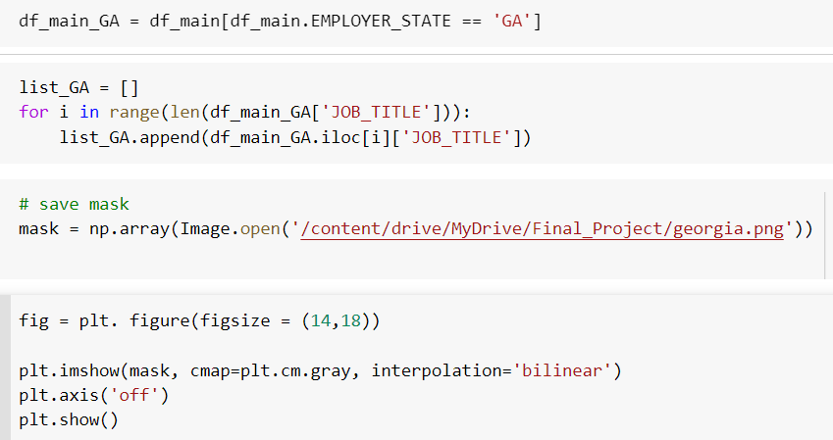
Code for Top Job Titles in Georgia Wordcloud
Notes:
Tania:

Slide 15

Top Job Titles in Georgia Wordcloud
Most frequent job title/ job with the most PW application is Software Engineer in the state of Georgia
Notes:
Tania:
Most of the jobs from the program in Georgia are in the Software Engineering field or in the IT sector.

Slide 16
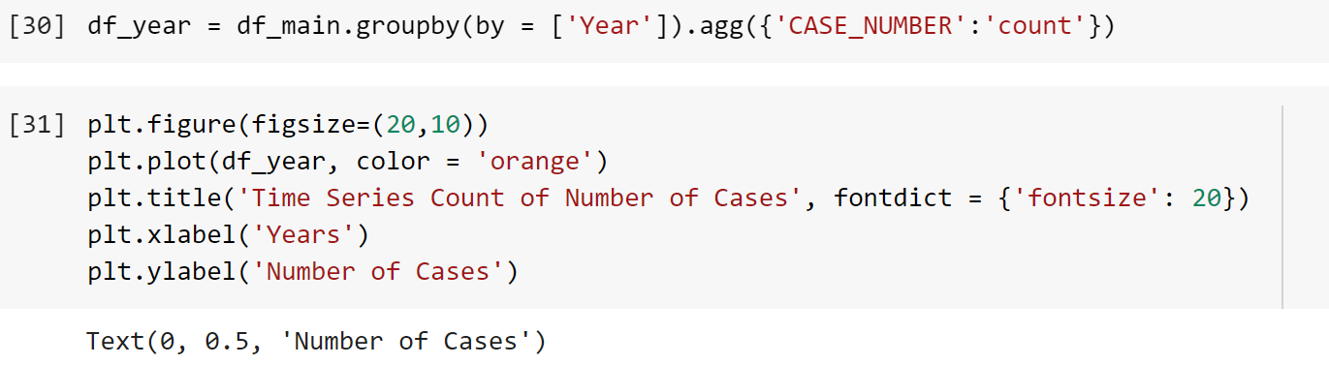
Code for plotting number of cases in the US PWD 2012 - 2020
Notes:
Tania:

Slide 17
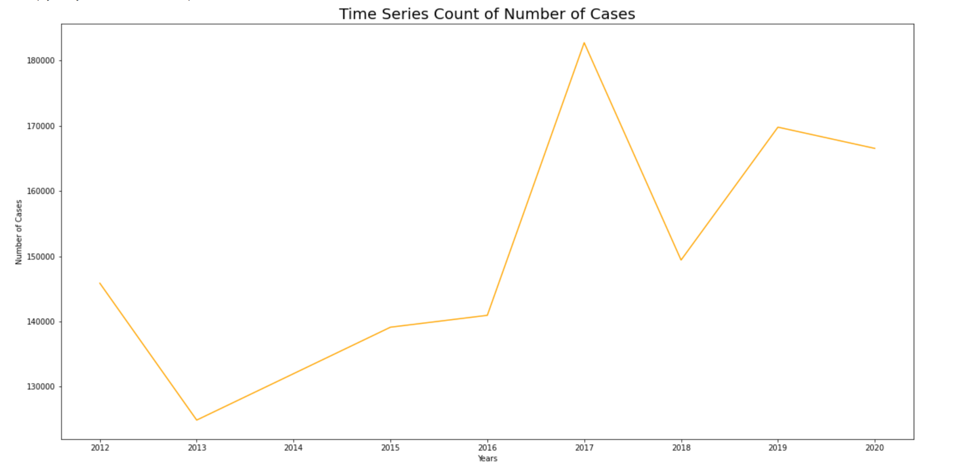
Trend of Number of Cases in the US Prevailing Wage Program from 2012 to 2020
Highest number of cases noted in 2017
Notes:
Tania:
Number of cases shot up in 2017, otherwise had a steady progression rate that is tapering off in 2020. Possibly due to change in administration and the pandemic.

Slide 18
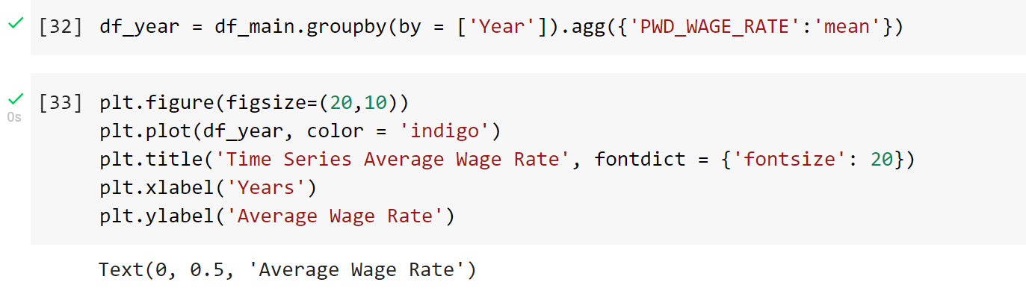
Code for plotting average wage in the US PWD 2012 - 2020
Notes:
Leticia:

Slide 19
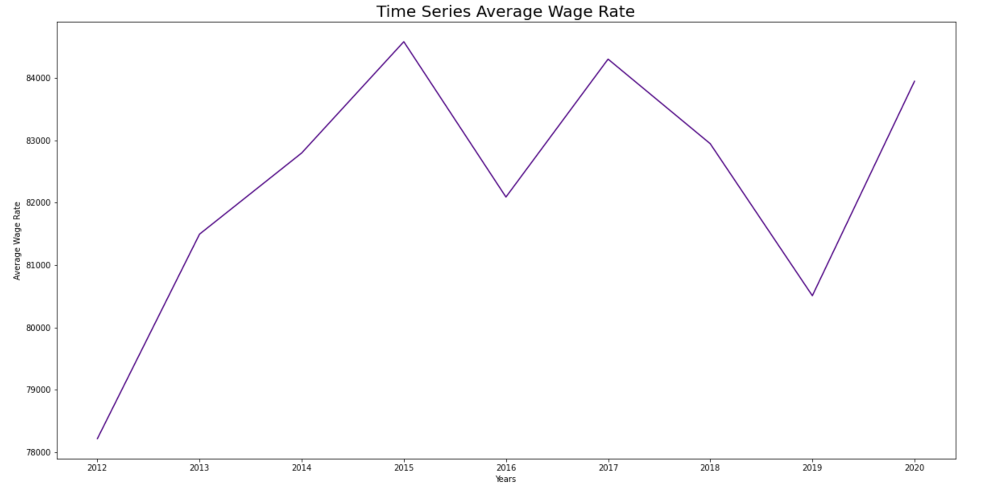
Trend of Average Wage in the US Prevailing Wage Program from 2012 to 2020
Notes:
Average wage in the program has increased by a few thousand dollars over the decade.

Slide 20
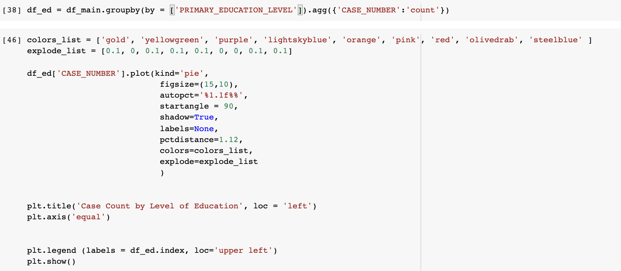
Code for pie chart showing number of cases based on level of education

Slide 21
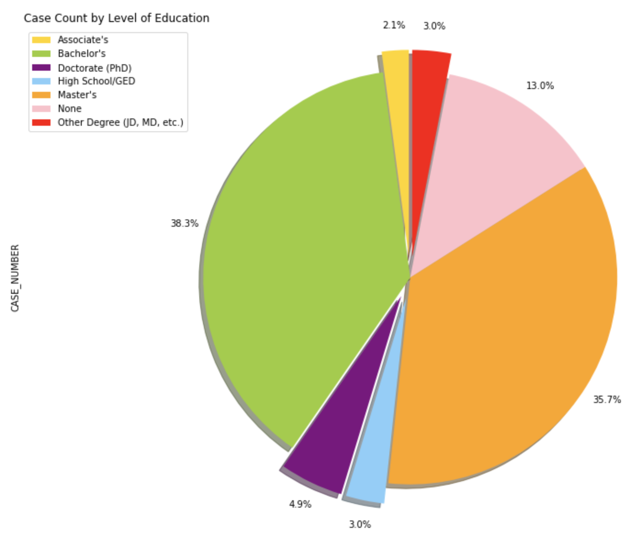
Pie chart showing number of cases based on level of education
Majority of the employees with PWD applications had either a Master’s degree or a bachelor’s degree.
About 13% of the applicant’s had no recorded level of education
Notes:
Generally participants in the programs hold a college degree of either Bachelor’s or Master’s.

Slide 22
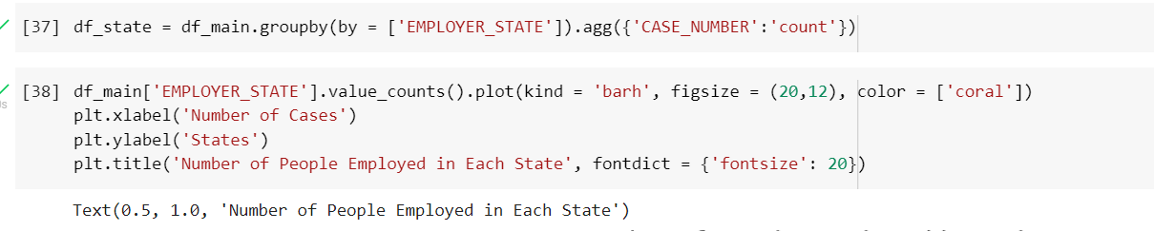
Code for graphing case numbers per state

Slide 23
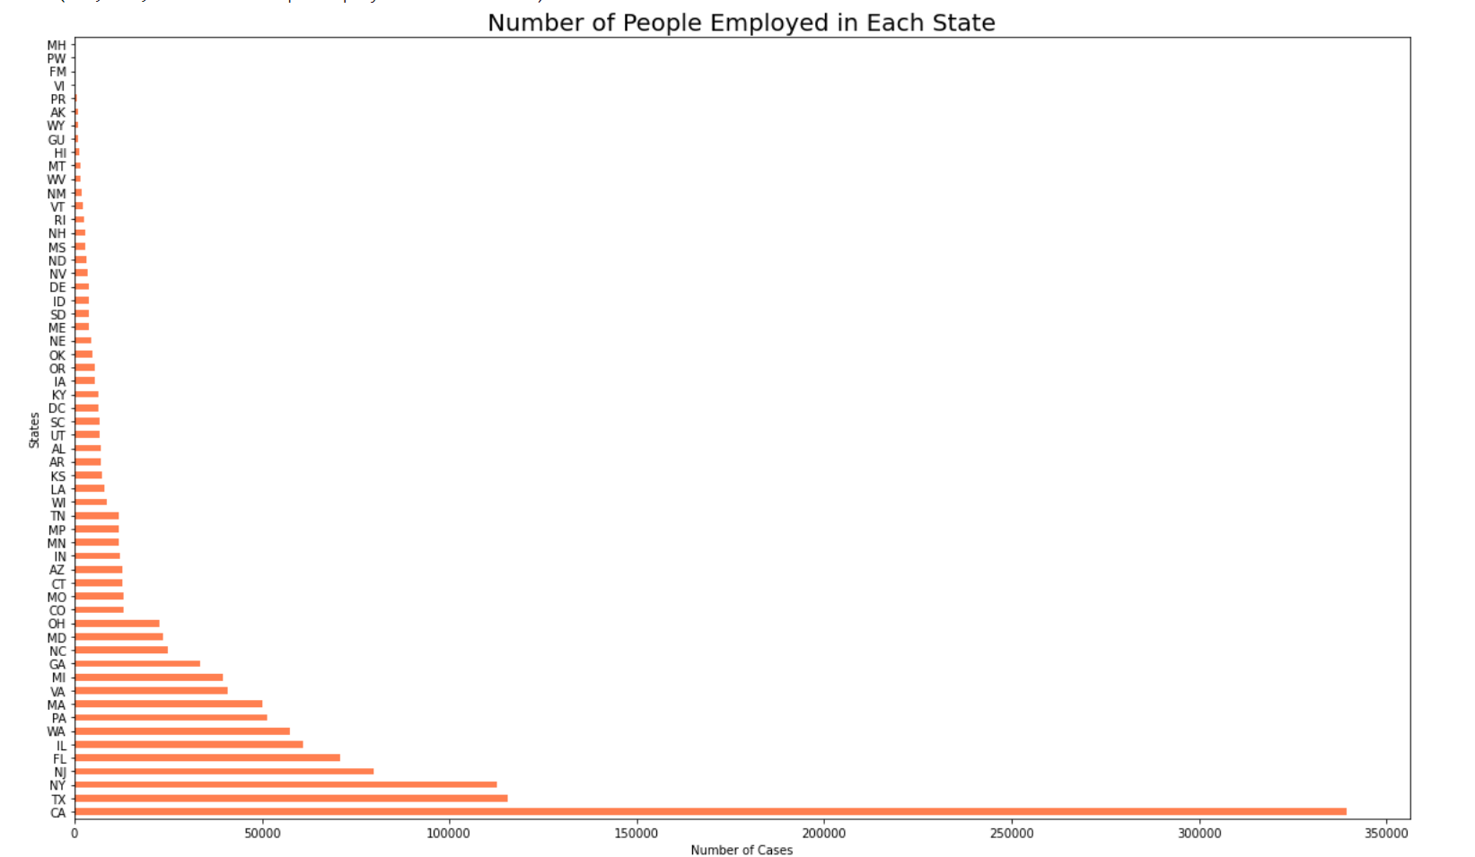
Horizontal Bar Graph for Number of Workers in each of the 50 states in the US
California had the highest number of applicants by a wide margin.
Notes:
California holds at least over a 100,000 more employees than all of the other states.

Slide 24
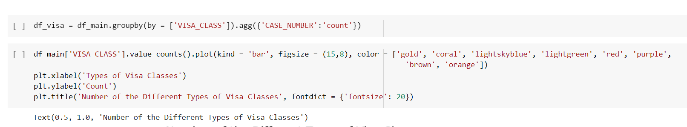
Code for Case Counts based on Visa Status

Slide 25
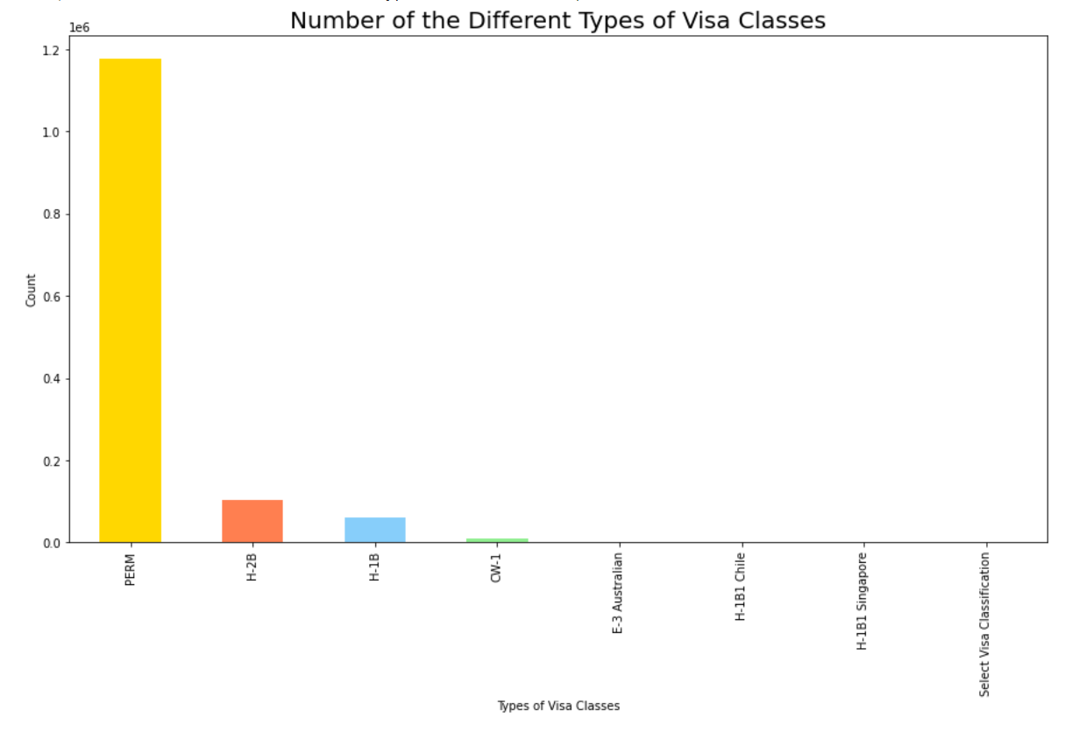
Case Counts based on Visa Status
Permanent Labor Certification consists of nearly 120,000 people in the US Prevailing Wage Program.
Notes:
Majority of the participants hold the Permanent Labor Certification title.

Slide 26
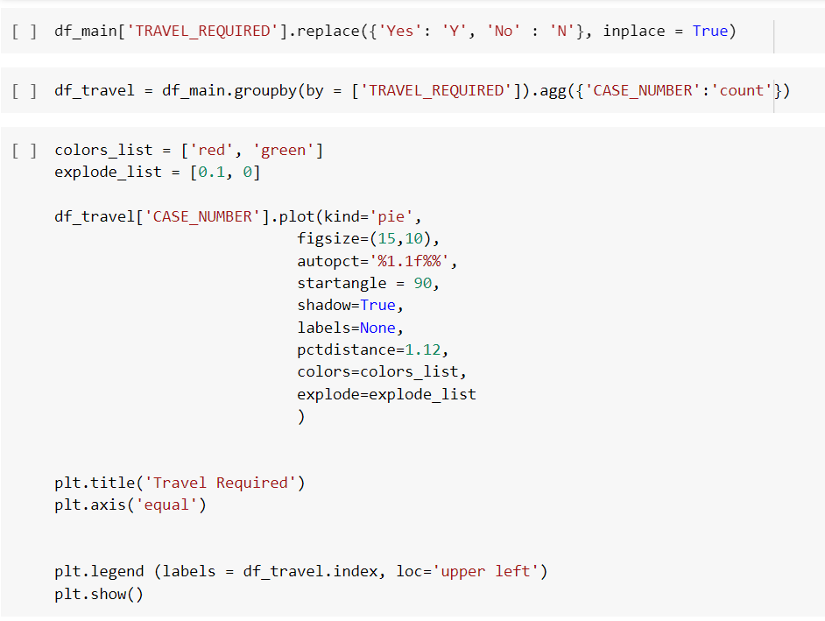
Code to see how many jobs require travel

Slide 27
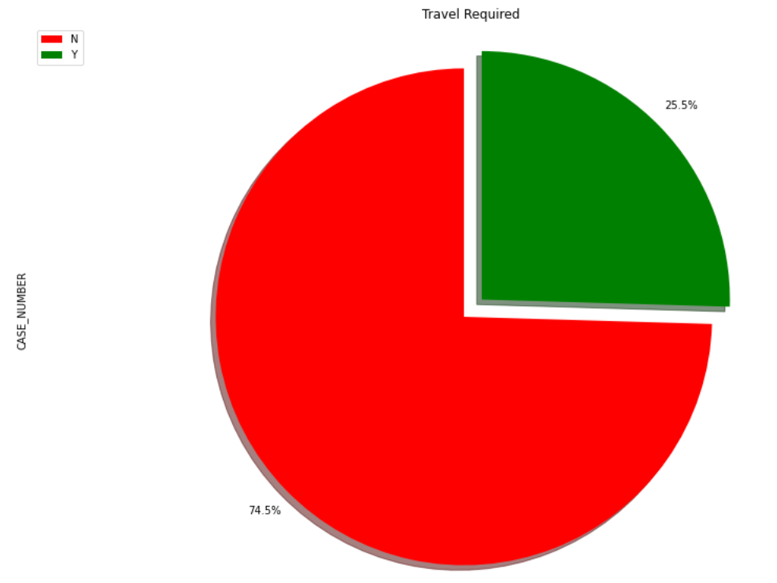
Pie Chart for Amount of Jobs Requiring Travel
74.5% of the participants are not required to travel for their jobs.
25.5% of people are required to travel for their jobs.
Notes:
Here we can see that most of the employees don’t require travel and only 1/4th of the employees would require travel to work.

Slide 28
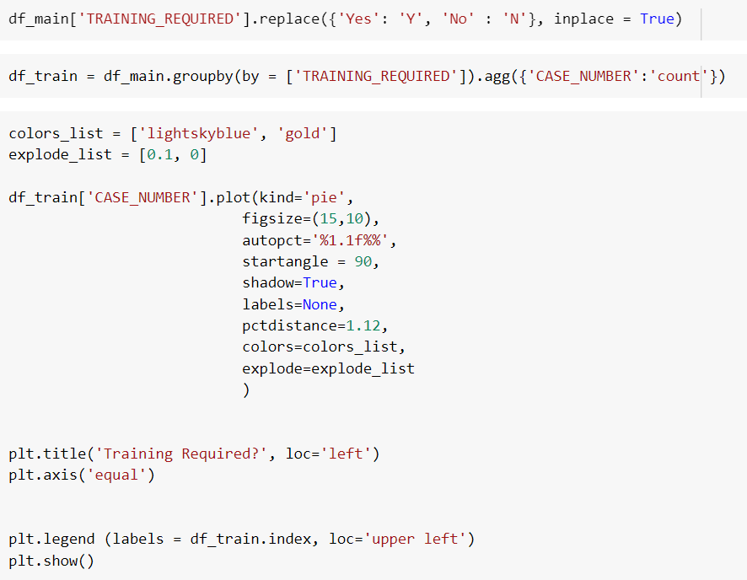
Code to see how many jobs require training

Slide 29
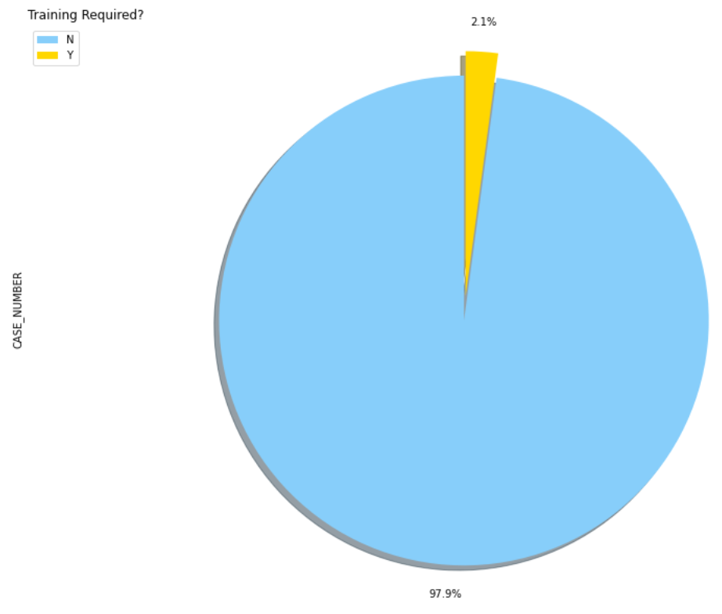
Pie Chart for Amount of Jobs Requiring Training
97.9% of the participants are not required to go through training for their jobs.
2.1% of people do require training for their jobs.
Notes:
Most of the employees don’t require training for their jobs. It can be assumed that the skills required to perform the jobs are gained from the level of education.

Slide 30
El fin.

